Slide 1

TMDB MOVIE DATA ANALYSIS
TMDB MOVIE DATA ANALYSIS
Project by,
Date- 12/09/2023
Name-Vighnesh S Udaiyar
Course Name- Data Analysis
Batch –January 2023
Wave- DAS31
Mentor- Mr. Sagar Bhilare

Slide 2


TMDB MOVIE DATA ANALYSIS
PROJECT OBJECTIVE
The objective of the project is to use Python Programming to analyze the movie data to perform exploratory data analysis by answering the questions in the upcoming slides.

Slide 3
TMDB MOVIE DATA ANALYSIS
Introduction
The movies that costs over $100 million can still, why so?. Movie lovers might have different interests.
A production company wants to analyze a movie dataset to identify what kind of movies perform well in cinemas, which genres they belong to ,and so on. It will help the company predict if a movie will be highly rated, etc.
Management wants to get the insights and so there are few tasks in the upcoming slides which needs to be answered using the python notebook.

Slide 4
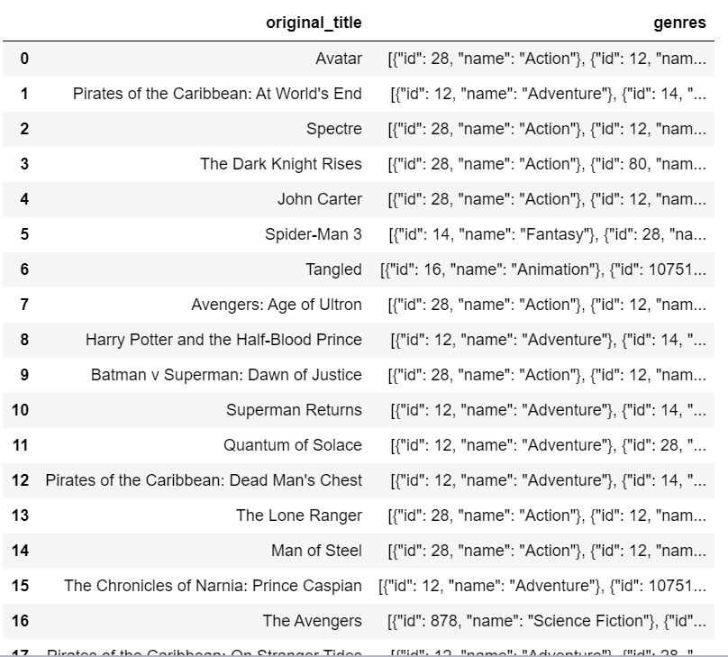

SYNTAX: df=pd.read_csv("DS1_C8_V3_ND_Sprint2_Data Analysis Using Python_Dataset.csv") df first_50_movies = df.head(50) # Displays the top 50 movie title and genres titles_and_genres = first_50_movies[['original_title','genres']] titles_and_genres
TMDB MOVIE DATA ANALYSIS
#Task 1 - Load the movie dataset in the Python notebook. Display the number of rows and columns in the dataset. Display the titles and genres of the first 50 movies from the dataset.
Output
Interpretation
We have loaded the dataset in the jupyter notebook and there are 4803 rows and 20 columns.
The First 50 movies along with the genres are show in the right.

Slide 5
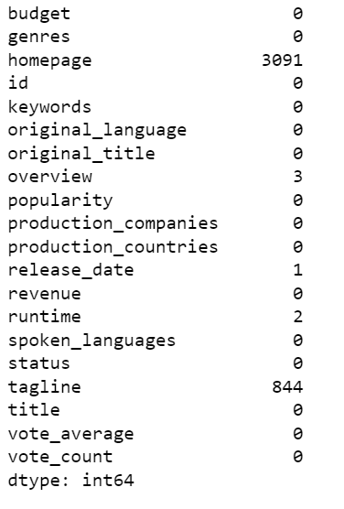
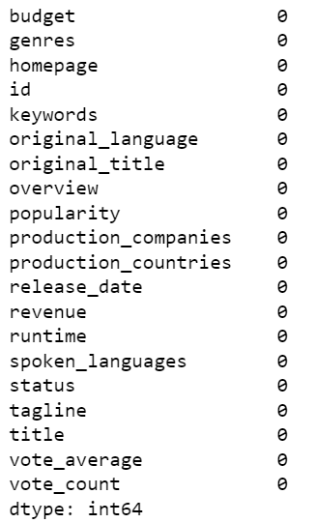
SYNTAX: df.isnull().sum()
TMDB MOVIE DATA ANALYSIS
#Task 2 identify the columns that have null values and perform the null values and perform the null value treatment.
Output before treatment
Output after treatment
Interpretation
Homepage,Overview,release_date,runtime,tagline has a null values.
The Homepage,overview,tagline,date are replaced with mode values.
The runtime is replaced with mean value.
The output before and after treatment

Slide 6
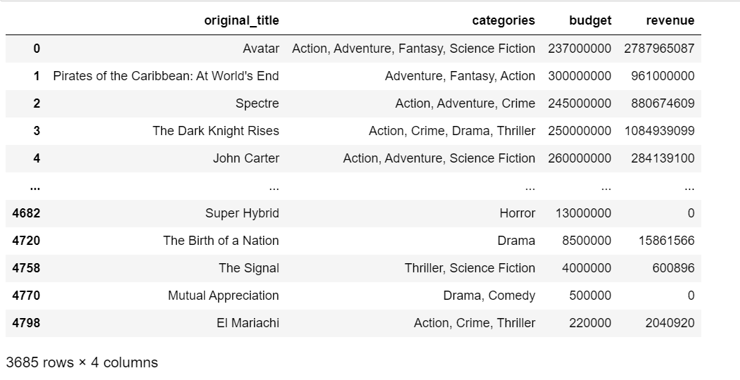
SYNTAX: Task_3= df[(df.budget>=220000)] Task_3 p=["original_title","categories", "budget", "revenue"] Task_3[p]
TMDB MOVIE DATA ANALYSIS
#Task 3 Display the movie categories that have a budget greater than $220,000.
Output
Interpretation
There are 3684 rows has been displayed which the movies categories budget greater than $220000.

Slide 7
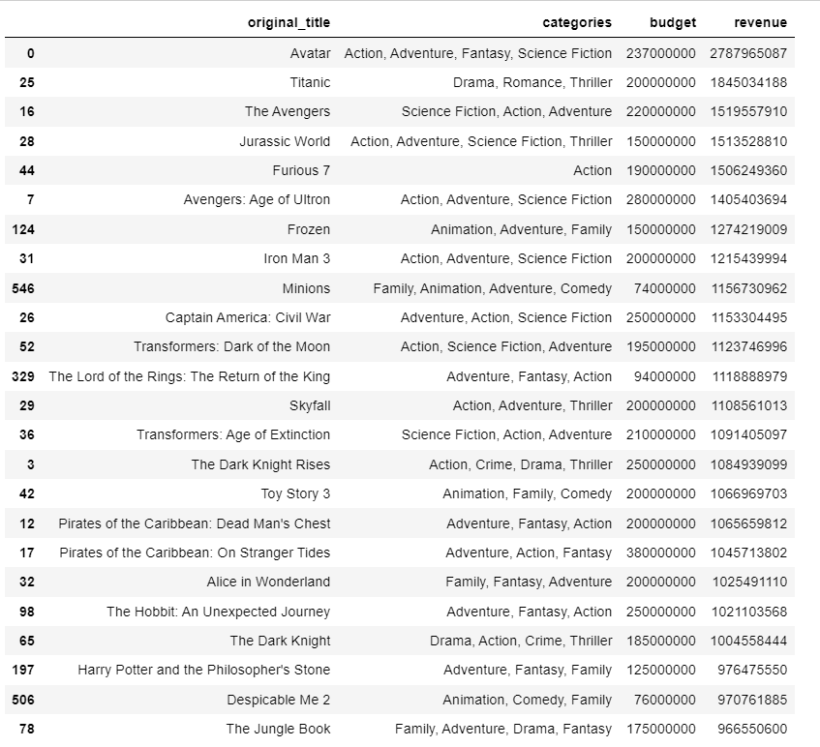
SYNTAX: Task_4= df[(df.revenue > 961000000)] Task_4=Task_4.sort_values("revenue", ascending=False) p=["original_title","categories","budget", "revenue"] Task_4[p]
TMDB MOVIE DATA ANALYSIS
#Task 4 Display the movie categories where revenue is greater than $961000000?
Output
Interpretation
24 rows has been displayed which the movies categories revenue greater than 961000000?.

Slide 8
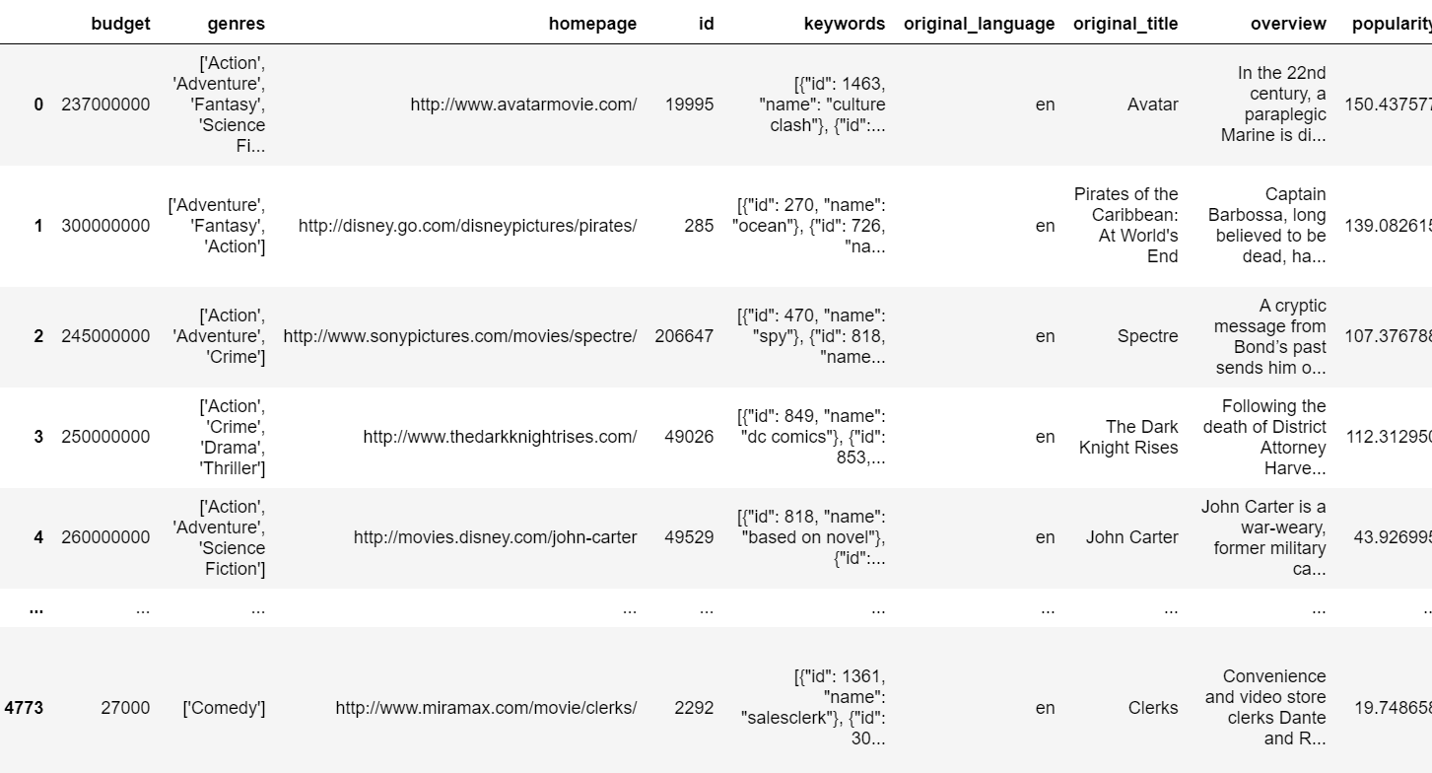
SYNTAX: df=df[((df.budget!=0) &(df.revenue!=0))] df
TMDB MOVIE DATA ANALYSIS
#Task 5 In the dataset, there are some movies for which the budget and revenue columns have the value 0, which mean unknown values. Remove the rows with value 0 from both the budget and revenue columns.
Output
Interpretation
Budget and revenue rows with the value 0 has been dropped.
The output after treatment

Slide 9
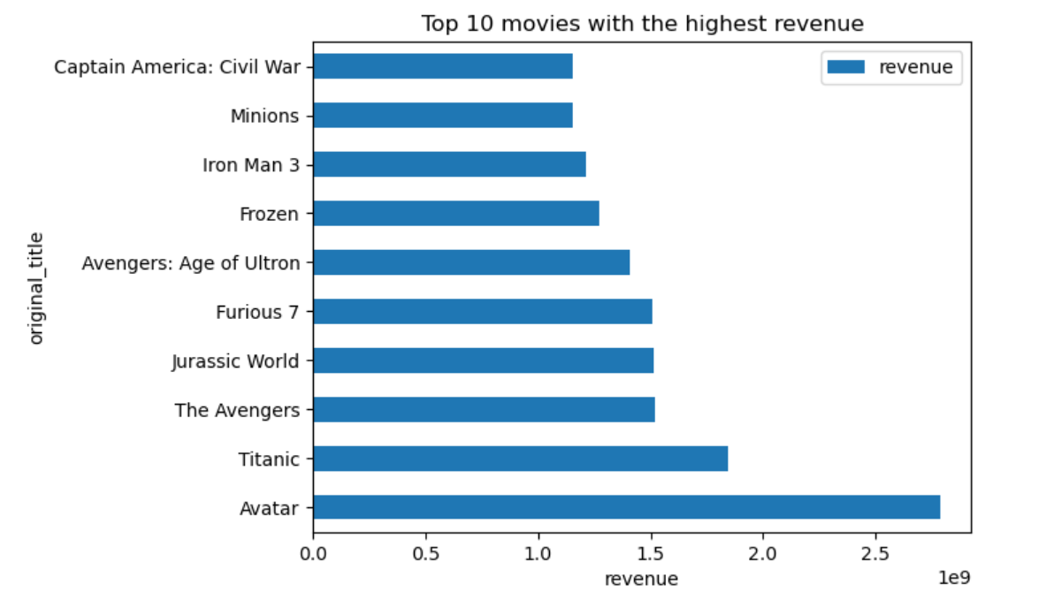
SYNTAX: top10_Rev=df.groupby('original_title')[['revenue']].max() sorted_rev=top10_Rev.sort_values('revenue',ascending=False)[:10] sorted_rev
TMDB MOVIE DATA ANALYSIS
# Task 6i list the top 10 movies with the highest revenues
Interpretation
The top 10 movies with the highest revenue are shown in the right.
‘Avatar’ has earned a highest revenue
$ 2787965087.
Output

Slide 10
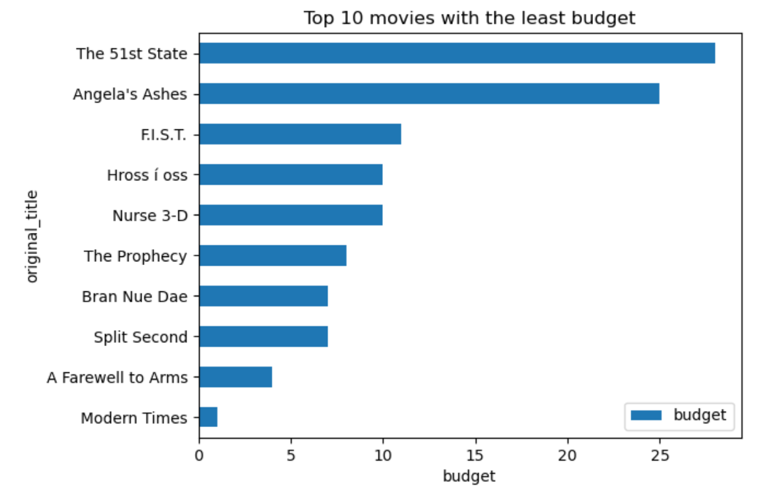
SYNTAX: top10_budget=df.groupby('original_title')[['budget']].min() sorted_budg=top10_budget.sort_values('budget')[:10] sorted_budg
TMDB MOVIE DATA ANALYSIS
#Task 6.ii Display the top movies with the least budget
Interpretation
The top 10 movies with the the least budget are shown in the right.
‘Modern times’ has least budget among the
top 10.
Output

Slide 11
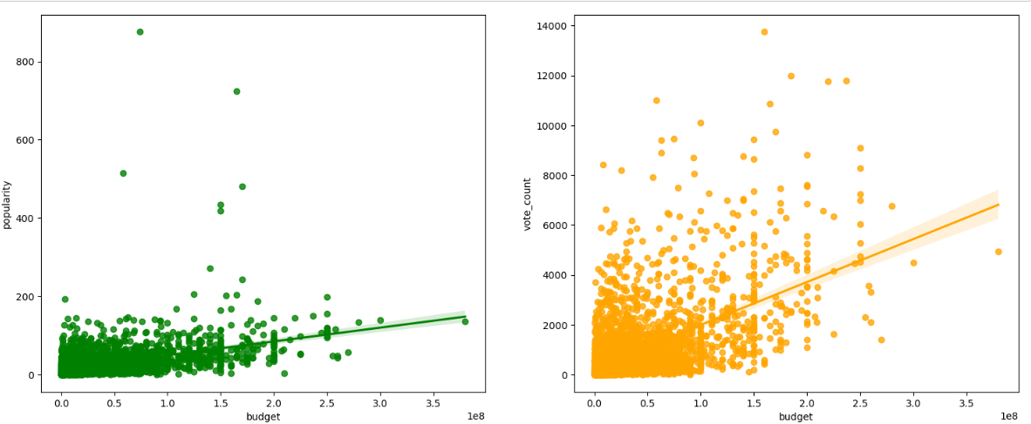
SYNTAX: correlation=df['budget'].corr(df['popularity']) print(f"Correlation between budget and popularity: {correlation}")
TMDB MOVIE DATA ANALYSIS
#Task 7 How are popularities of movies with the movies budgets? Are they correlated or totally uncorrelated with each other ?write the interpretation of our analysis
Interpretation
Correlation between budget and popularity: 0.431
This means there is a weak positive correlation.
On the basis of only vote count the top performing movie is inception i.e. this movie has got the maximum votes.
On the basis of revenue generation movie avatar and titanic are the top performers.
On the basis of the correlation between revenue and vote count , we are getting similar number of movies that are performing and not doing so well.
Only vote count cannot tell whether a movie will be a commercial success or not.
Output

Slide 12
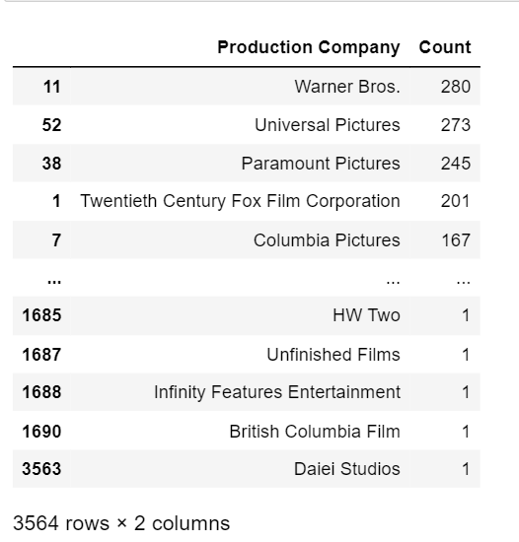
SYNTAX: # # Initialize an empty dictionary to store production company names and their counts production_counts = {} # Iterate over each row in the DataFrame for row in df.itertuples(index=False): # Iterate over each production company in the row for company in row.production_companies: # Extract the production company name company_name = company['name'] # Increment the count for the production company if company_name in production_counts: production_counts[company_name] += 1 else: production_counts[company_name] = 1 # Create a new DataFrame to store the production company names and their counts production_df = pd.DataFrame({'Production Company': list(production_counts.keys()), 'Count': list(production_counts.values())}) # Sort the DataFrame by count in descending order production_df = production_df.sort_values('Count', ascending=False) production_df
TMDB MOVIE DATA ANALYSIS
#Task 8 Identify and display the names of all the production companies along with the number of times they appear in the dataset.
Interpretation
‘Warner Bros’ Production company is repeating most of the times 280,followed by Universal pictures 273
Interpretation
‘Warner Bros’ Production company is repeating most of the times 280,followed by Universal pictures 273

Slide 13
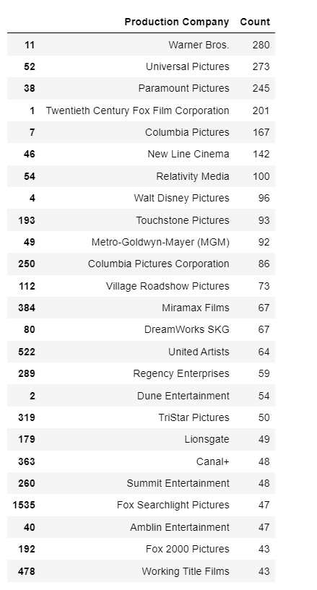
SYNTAX: production_df = production_df.sort_values('Count', ascending=False) # Select the top 25 production companies based on count top_25_companies_pc = production_df.head(25) top_25_companies_pc
TMDB MOVIE DATA ANALYSIS
#Task 9 Display the names of the top 25 production companies based on the number of movies they have produced in descending order of the number of movies produced.
Interpretation
‘Warner Bros’ Production company is repeating most of the times 280,followed by Universal pictures 273
This companies are the top among the top 25 companies.
People tend to watch the movies produced by these production house.

Slide 14
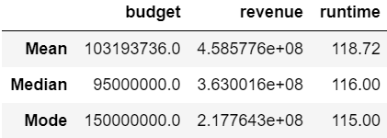
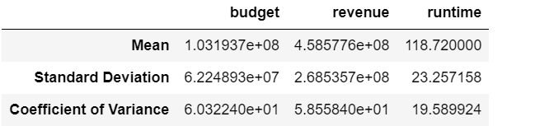
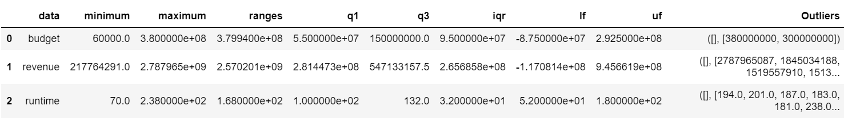
SYNTAX: sort_500=df.sort_values('revenue',ascending=False).head(500) sort_500 final_data=sort_500[['budget','revenue','runtime']] final_data Central_tend=pd.DataFrame([Mean,Median,Mode],columns=cols,index=index) Central_tend Measures_Desper=pd.DataFrame([Mean,STD,CV],columns=cols,index=index) Measures_Desper outliers=pd.DataFrame([budget,revenue,runtime],columns= ['data','minimum','maximum','ranges','q1','q3','iqr','lf','uf','Outliers']) outliers
TMDB MOVIE DATA ANALYSIS
#Task 10 Sort the data in descending order based on revenue and filter the top 500 movies. Find the measures of central tendency for the following columns using the filtered data:
Interpretation
From the top 500 movies the mean, median ,mode, standard deviation, outliers is shown in the right

Slide 15
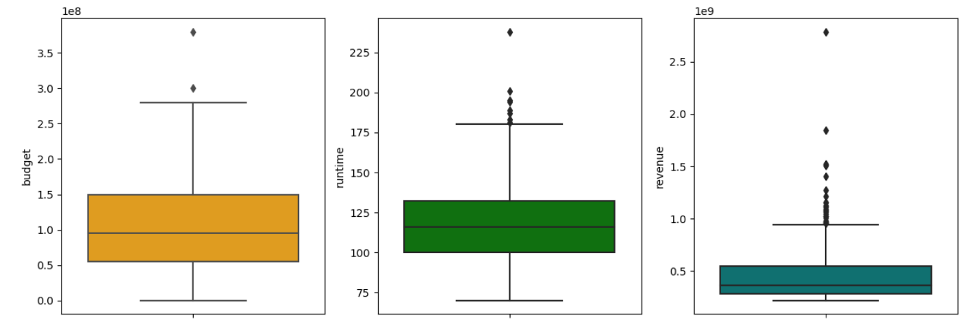
SYNTAX: set_palette="pastel" fig,ax=plt.subplots(1,3,figsize=(15,5)) sns.boxplot(y=ct['budget'],ax=ax[0], color="orange") sns.boxplot(y=ct['revenue'],ax=ax[2],color="teal") sns.boxplot(y=ct['runtime'],ax=ax[1],color="green") plt.show()
TMDB MOVIE DATA ANALYSIS
#Task 10 CONTINUED
Interpretation
On the basis of measures of central tendency ie. Mean, median , and mode for budget , runtime, revenue.
Mean is greater than the median for all the three parameters , which shows the data is positively skewed.
On the boxpot for budget and runtime there are very less number of outliers.
For revenue the data is more concertrated till $500 billion and some outliers are also present in the data .
Due to the presence of outliers the mean is drawn towards the higher values and cause skewness in the data.
Output

Slide 16
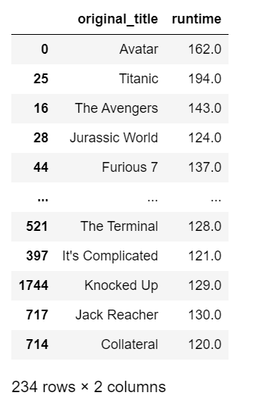
SYNTAX: task11=sort_500[(sort_500.runtime)>(sort_500.runtime).mean()] task11=task11[['original_title','runtime']] task11
TMDB MOVIE DATA ANALYSIS
# Task 11 Identify and display the names of the movies along with their run times for those movies that have above average run time, using the data from the previous task
Interpretation
There are around 234 movies where the runtime is greater than the average runtime.
After Sorting in largest to lowest runtime ,the ‘GONE WITH THE WIND’. has the longest runtime of 238mins.
Output

Slide 17
Conclusion --
On the basis of revenue only we can determine whether a movie is a commercial success or not, but yes budget, popularity, vote count all contribute towards a commercial success.
In terms of correlation between budget and revenue i.e 0.71 , for a movie to be a commercial success , contribution of budget is only 7/10 i.e 7 out of 10 movies with high budget can be a commercial success.
In terms of popularity , 6 out of 10 movies that have high popularity can become a commercial success, since the correlation between popularity and revenue is 0.61
In terms of vote count , 8 out of 10 movies that have a high votecount can be a commecial success.

Slide 18
THANK YOU …

